Slide 1
Cardiac Disease in Pregnancy
Loralei L. Thornburg, M.D.
She/her
Professor of Ob/Gyn
Director Maternal-Fetal Medicine
University of Rochester, NY

Slide 2
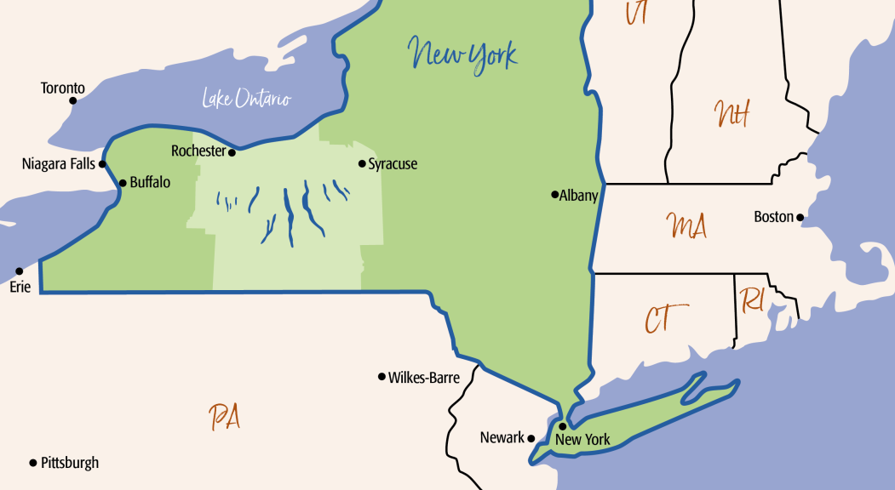

Slide 3
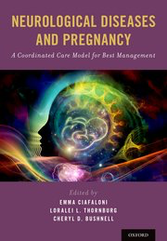
Disclosures
I have no relevant conflicts of interest to disclose
I have a book on neurologic disorders in pregnancy
I teach at the SMFM critical care course
I will not discuss any off-label use and/or investigational use

Slide 4
Learning Objectives
List the congenital and acquired cardiac lesions of concern in pregnancy
Describe the medications used to control cardiac symptoms in pregnancy and their safety profiles
Understand best practices around labor management in women with cardiac disease in pregnancy

Slide 5
Maternal Mortality in Pregnancy
Cardiac diseases
Direct Pregnancy diseases
Clotting diseases

Slide 6
Rising incidence & risk….
1-4% of pregnancies have CVD disease
Congenital heart disease (CHD) and acquired HD (AHD)
BOTH on the rise!
AHD
Rising risk of death
Illinois:
22% of deaths related to CVD
97% had AHD (CM, CAD, aortic dissection)
CHD:
Maternal morbidity/mortality stable at 0.5% & 11%
Marelli, A. J., et. al. (2014).
Canobbio, M. M., et. al. (2017).

Slide 7
Risk factors for CVD in pregnancy
Age >40
raises risk CVD-related death 30x
Race/Ethnicity
non-Hispanic black women 3.4x
Independent of other variables
Hypertensive disorders of pregnancy
Pre-pregnancy obesity
Prior cardiac disease

Slide 8
Congenital cardiac disease
2% of maternal CV disease
Most common type of cardiac disease affecting pregnancy
Increasing in frequency
Since 2005, there are now more adults with CDH then children
prevalence of complex CHD is rising in adults, remains stable in children¹
Most women born with CHD will reach reproductive age²
Pregnancy:
Not an automatic exclusion
Poses ↑ risk
Evaluation & consult PRIOR to conception
Even “same” lesions can behave very differently

Slide 9
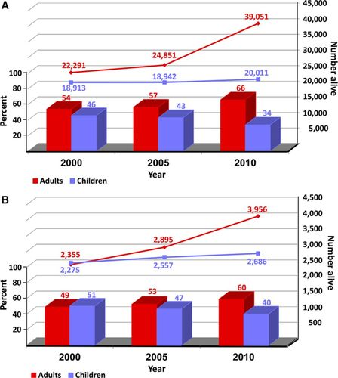
Congenital cardiac disease
All CHD
Severe CHD
Marelli. Circulation. 2014
© 2014 American Heart Association, Inc.

Slide 10
Under treated cardiac disease is NOT GOOD for anyone- patient or baby
No patient should be denied standard cardiac therapy because of pregnancy
No medication is as dangerous as cardiac arrest

Slide 11
Ask the question…
What therapy/surgery/imaging/medication would you do if she was not pregnant ?

Slide 12
Predicting Pregnancy Risk
Getting ready for pregnancy
Assessing pregnancy risk
Pre-pregnancy evaluation

Slide 13
Hemodynamic Changes
Pregnancy is generally well tolerated
>40% ↑ in blood volume
↓ in SVR and PVR
↑ in HR 10-20%
Little change in BP
Labor
CO ↑ 60-80%
HR and BP changes
Volume changes
↑ blood volume with uterine contraction
↑ venous return
Volume loss during delivery
30% ↑ Cardiac Output (CO)

Slide 14
Pregnancy Risk
Regurgitant valve lesions
generally well tolerated
Complex lesions
assess on case by case basis
Risk of inheritance
3-5% with most CHD
Genetic disorders
Maternal, paternal or 1st degree relative → Fetal echo

Slide 15
WHO- Risk in pregnancy Congenital HD
Extremely high risk mortality morbidity
Contraindicated
PHTN
Severe Coarctation
Aorta >50 mm with BV
Severe Mitral or Aortic Stenosis
Significantly increased risk mortality or morbidity
Systemic RV
Fontan circulation
Cyanotic heart disease (unrepaired)
Aorta >45 mm with bicuspid valve (BV)
High risk WHO III
Lower risk WHO I
Small increased risk mortality or moderate increase morbidity
Extremely High risk – WHO IV
Moderate risk WHO II
Repaired Tetralogy
UNrepaired ASD, VSD
Aorta <45 mm with bicuspid valve (BV)
Repaired coarct
No detectable increased risk mortality
Repaired PDA, ASD, VSD
Notes:
Ask casey about gabapentin, phenobarb

Slide 16
WHO- Risk in pregnancy Acquired HD
Extremely high risk mortality morbidity
Contraindicated
PHTN
Marfan’s w/ aortic >45
h/o PPCM w/ residual LV dysf
LVEF <30%/NYHA III/IV
Significantly increased risk mortality or morbidity
High risk WHO III
Mechanical valves
Marfan’s w/ aortic dilation 40-45
Lower risk WHO I
Small increased risk mortality or moderate increase morbidity
Extremely High risk – WHO IV
Most arrhythmias
LV impairment
Hypertrophic cardiomyopathy
Non-WHO I valve disease
Marfan’s w/o aortic dilation
Moderate risk WHO II
No detectable increased risk mortality
Mild Pulmonary Stenosis
MVP
Occasional ectopy
???
Prior MI or stenting
Recover PPCM but was <20%
Notes:
Ask casey about gabapentin, phenobarb

Slide 17
Overall Maternal Cardiac Event Rate in Pregnancy by WHO Class
Silversides et al. Outcomes of Pregnancy in Women With Heart Disease JACC 2018. 71(21):2419–30

Slide 18
Pregnancy Outcome in CV Disease
Prospective observational data on heart disease in pregnancy (CARPREG)
Few patients with CHD included
562 women with 599 pregnancies
13% of pregnancies complicated
Pulmonary edema, arrhythmia, stroke, cardiac death
Siu SC et al: Circulation 2001

Slide 19
Predictors of Cardiac Events
Risk factors
Prior CHF, TIA, stroke or arrhythmia
Baseline NYHA class >II or cyanosis
Left heart obstruction
MVA < 2, AVA < 1.5
LVOT grad >30 mmHg
EF <40%
Cardiac Event
Rate (% preg)
Number of predictors
Siu SC et al: Circulation 2001

Slide 20
ZAHARA study
Observational data on CHD in pregnancy
1802 women, 1302 completed pregnancies
Cardiac complications in 7.6%
Most common CV complications
Arrhythmias 4.7%
Heart failure 1.6%
Drenthen et al: Eur Heart J 2010

Slide 21
Predictors of Maternal CV Complications
Cyanotic heart disease (p < 0.0001)
Cardiac meds pre-pregnancy (p < 0.0001)
Left heart obstruction (p < 0.0001)
Mechanical valve prosthesis (p = 0.0014)
Systemic or pulmonary AV valve regurgitation related to complex CHD (p = 0.03)
Drenthen et al: Eur Heart J 2010

Slide 22
Modified Risk Score of CV Complications During Pregnancy
History of arrhythmias 1.50 points
Cardiac medication before pregnancy 1.50 points
NYHA class prior to pregnancy ≥1 0.75 points
LHD (PG >50 mm Hg or AVA <1.0 cm²) 2.50 points
Syst AV valve regurgitation (moderate/severe) 0.75 points
Pulm AV valve regurgitation (moderate/severe 0.75 points
Mechanical valve prosthesis 4.25 points
Cyanotic heart disease (corrected/uncorrected) 1.00 points
Total number of points 0-13 points
Drenthen et al: Eur Heart J 2010

Slide 23
Modified Risk Score of CV Complications During Pregnancy
History of arrhythmias 1.50 points
Cardiac medication before pregnancy 1.50 points
NYHA class prior to pregnancy ≥1 0.75 points
LHD (PG >50 mm Hg or AVA <1.0 cm²) 2.50 points
Syst AV valve regurgitation (moderate/severe) 0.75 points
Pulm AV valve regurgitation (moderate/severe 0.75 points
Mechanical valve prosthesis 4.25 points
Cyanotic heart disease (corrected/uncorrected) 1.00 points
Total number of points 0-13 points
Cardiac complications in % of total number pregnancies
*
Risk score
Pregnancies at risk (no.) 828 280 126 58 10
Percentage of total population 63.6 28.1 6.1 1.4 0.8
Drenthen et al: Eur Heart J 2010

Slide 24
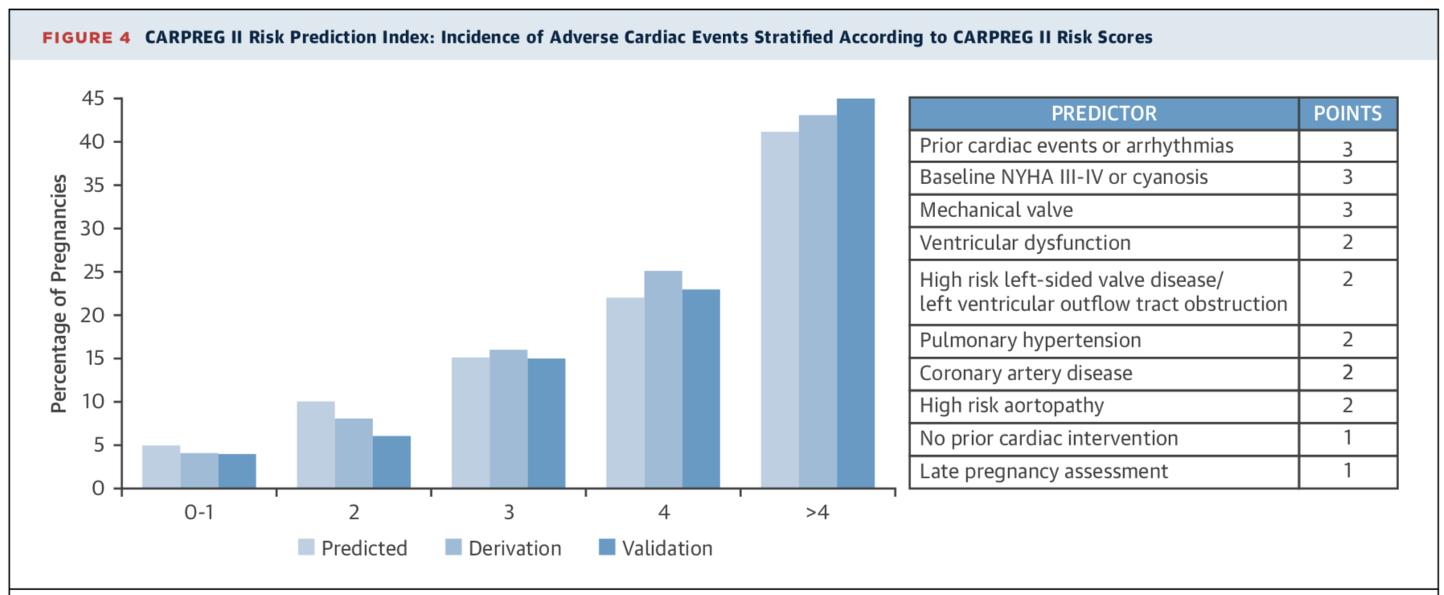
CARPREG II Score
Silversides et al. Outcomes of Pregnancy in Women With Heart Disease JACC 2018. 71(21):2419–30

Slide 25
Pregnancy Not Advised
Severe pulmonary arterial hypertension
Severe obstructive lesions
AS, MS, PS, HCM, Coarctation
Ventricular dysfunction
CHF - NYHA Class III or IV, EF <40%
Prior peripartum cardiomyopathy
Dilated or unstable aorta
Marfan with aorta ≥40-45 mm
Severe cyanosis

Slide 26
Offspring Complications
Neonatal complications
Premature birth (12%)
Small for gestational age (14%)
Mortality (4%)
Predictors of adverse neonatal outcome
Cyanotic heart disease (P = 0.0003)
Mechanical valve replacement (P = 0.03)
Maternal smoking (P = 0.007)
Multiple gestation (P = 0.001)
Maternal use of cardiac medication (P = 0.0009)
Drenthen et al: Eur Heart J 2010

Slide 27
General approach to pregnancy

Slide 28
Pre-pregnancy Evaluation
History, exam, ECG, CXR
Med review
Exercise testing, Echo and additional imaging
If possible PHTN
Cardiac catheterization
Echo PHTN tends to overestimate PA pressures
Genetic considerations
Frequency of cardiac follow-up depends on type of CHD

Slide 29
Go for it! Safe & IMPROVE outcomes vs. untreated disease
Amioderone
Dig
Flecindine
Rthymal
∞ acetaminophen
∞ heparin
∞ low-molecular weight heparin
∞ aspirin
∞ Inhaled steroids
∞ Labetolol
∞ nifedipine
Do not use
Consider risks/benefit & pregnancy timing
∞ ibuprofen (till 20 wks)
∞ oral steroids
∞ Metoprolol (?increase IUGR)
∞ Anti-platelet medications
∞ Digoxin
∞ Flecainide
Ace/ARB inhibitors
Factor Xa oral anticoagulants
∞ generally compatible with breastfeeding, depending on dose

Slide 30
More medication questions?
(585) 275-3638 or 1 (844) 352-3420 (toll-free)
Or email MotherToBaby@urmc.rochester.edu
Chat & info at mothertobaby.org
Patients or docs
More meds in Lactation questions?
Lactation study center 585-275-0088
Doc to doc hotline
www.urmc.rochester.edu/breastfeeding.aspx

Slide 31
How often should we be seeing & imaging them?

Slide 32
What are we looking for?
Cardiac output
Heart Rate
Stroke Volume
Preload
Contractility
Afterload

Slide 33
Common Pathways For All Types Of Cardiac Disease
Final Common Pathway
Pulmonary edema
Arrhythmias

Slide 34
Delivery Mode & Anesthesia
Most patients with CHD and AHD are candidates for vaginal delivery
Some patients will require assisted second stage or cesarean delivery
Cesarean delivery
Obstetrical indications
Warfarin anticoagulation in labor- Due to fetal bleeding risks
Severe pulmonary hypertension
Fixed obstructive lesions - Sudden BP change dangerous
Unstable aorta
Anesthesia:
Most lesions tolerate well, especially those that benefit from reduced afterload-- AR, MR
Lesions that struggle with regional:
VSDs with Right/left shunt, MS, AS

Slide 35
CV Surgery During Pregnancy
21 CV operations during pregnancy (1976 – 2009)
Mortality - 3% maternal, 19% fetal
Fetal prematurity and death associated with urgent, high-risk surgery, maternal comorbidity, and early GA
Emergent surgery confers higher risk of maternal death
If intervention required
24-28 weeks best
Monitor fetus
High flow CPB; MAP >60 mm Hg; maintain normothermia
CT surgery can be performed with relative safety
John et al: Ann Thorac Surg 2011

Slide 36
Endocarditis Prophylaxis
Follow AHA guidelines
IE prophylaxis generally not required during uncomplicated delivery
Not required
Isolated ASD
6 months after PDA or VSD closure
Reasonable in high-risk patients
Marfan, cyanotic/complex CHD, valve prosthesis

Slide 37
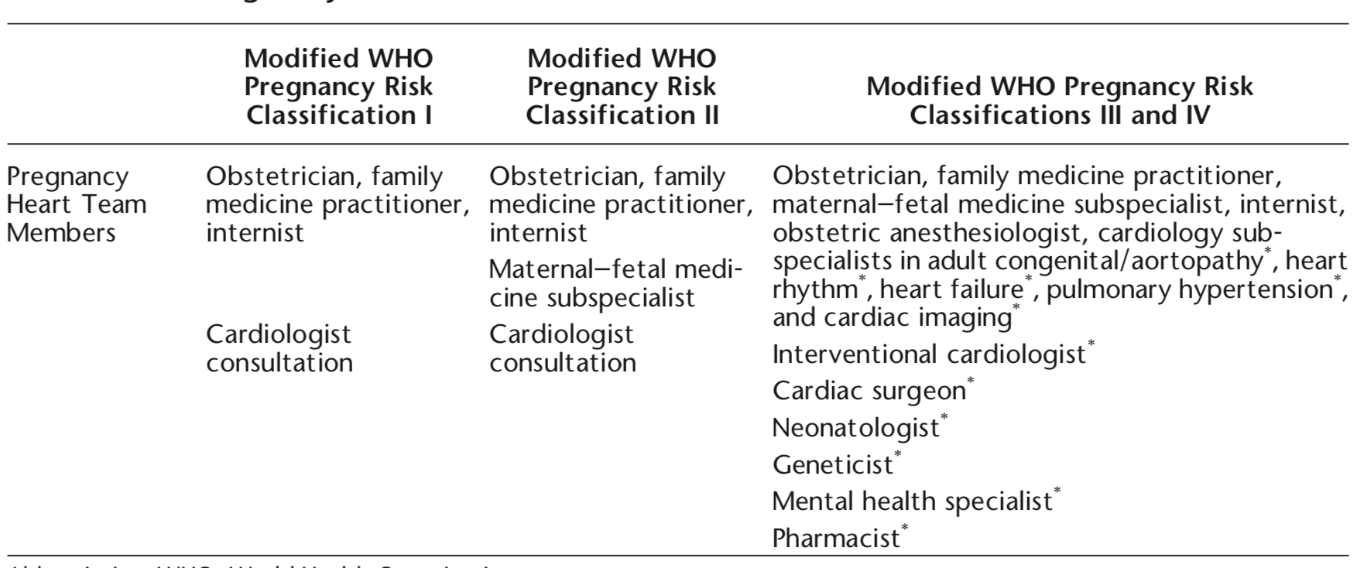
The Pregnancy Heart Team

Slide 38
Who do I work up for NEW or worsening heart disease?

Slide 40
Cardiomyopathy
Dilated
Hypertrophic
Peri-Partum

Slide 41
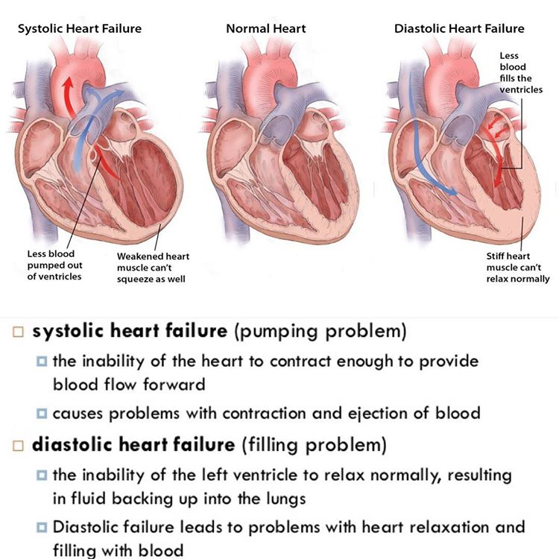
Consider echocardiogram and/or EKG in patients with several years of HTN,
especially if severe or other co-morbidities
Systolic dysfunction:
pump problem
problems with forward flow
Overflow/regurg goes back into lungs
REDUCE VOLUME
AVOID HTN (afterload sensitive)
IONTROPS
Diastolic dysfunction:
filling problem
flow that can’t move forward builds up in lungs
RATE CONTROL
Avoid TACHYCARDIA
Afib sensitive

Slide 42
Peripartum Cardiomyopathy Diagnostic Criteria
Classic
Development of heart failure within last month of gestation or 5 months postpartum
Absence of an identifiable cause for heart failure
Absence of recognizable cardiac disease before pregnancy
Additional
Left ventricular systolic dysfunction
Ejection fraction <45%
Shortening fraction < 30%
LV end-diastolic volume > 2.5 cm/m²
Pearson et al. JAMA 2000;283:1183. NIH workshop recommendations and review.

Slide 43
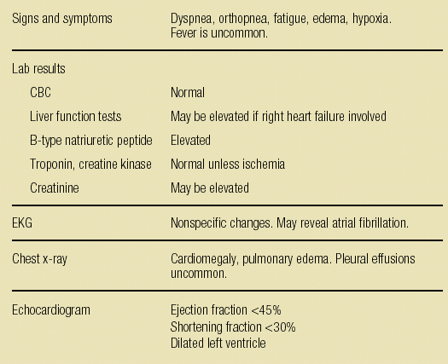
Clinical Presentation 90% cases occur 1st 2 months postpartum
Martin S. Contemp OBG April 2006

Slide 44
Cardiomyopathy Management Principles
Reduce cardiac preload
Reduce cardiac afterload
Improve contractility

Slide 45
NT-proB-type Natriuretic Peptide/BNP
Released by ventricles in response to volume and pressure overload
Elevated in proportion to the degree of LV dysfunction
Normal BNP levels helpful to exclude cardiac decompensation in pregnant women
BNP levels useful to assess patient with dyspnea and suspected CHF
Kampman et al EHJ 2014; Ker et al OB Med 2018
ACC/AHA Guidelines Yancy et al JACC 2017

Slide 46
Practical Management of PPCM & Cardiomyopathy
Preload reduction
Furosemide 20-40 mg daily
Use carefully in undelivered patients
Improve contractility
Inotropic Therapy
Digoxin 0.25-0.5 mg qd (goal serum level 1-2)
β-blocker therapy
Metoprolol (Lopressor®) 12.5-100 mg qd (goal HR 80-100)
Carvedilol (Coreg®) 3.125-25 mg bid

Slide 47
Practical Management of PPCM & Cardiomyopathy Afterload reduction
Control blood pressure with vasodilators (goal SBP <110)
Hydralazine 25 – 100 mg up to qid
or
Amlodipine (Norvasc®) 5-10 mg/day
or
Long acting nitroglycerin (Isordil®) 40 mg qd
Postpartum:
ACE inhibitor, ie enalapril (Vasotec®) 5 mg bid

Slide 48
Peripartum Cardiomyopathy
Mortality rate 15-20%
Recovery:
41-54% of patients will recover LV function
Up to 50% have complete recovery, ~30% partial recovery, 20% get worse
Predictors for POOR recovery:
EF < 30%
Fractional shortening < 20% and LV ED dimension > 6 cm
Elevated troponin T
Black race
Recurrence:
Risk for recurrence even if apparently recovered LV dysfunction
Up to 50% recurrence risk in subsequent pregnancy
Avoid pregnancy if persistent LV dysfunction – high risk for decompensation and mortality

Slide 49
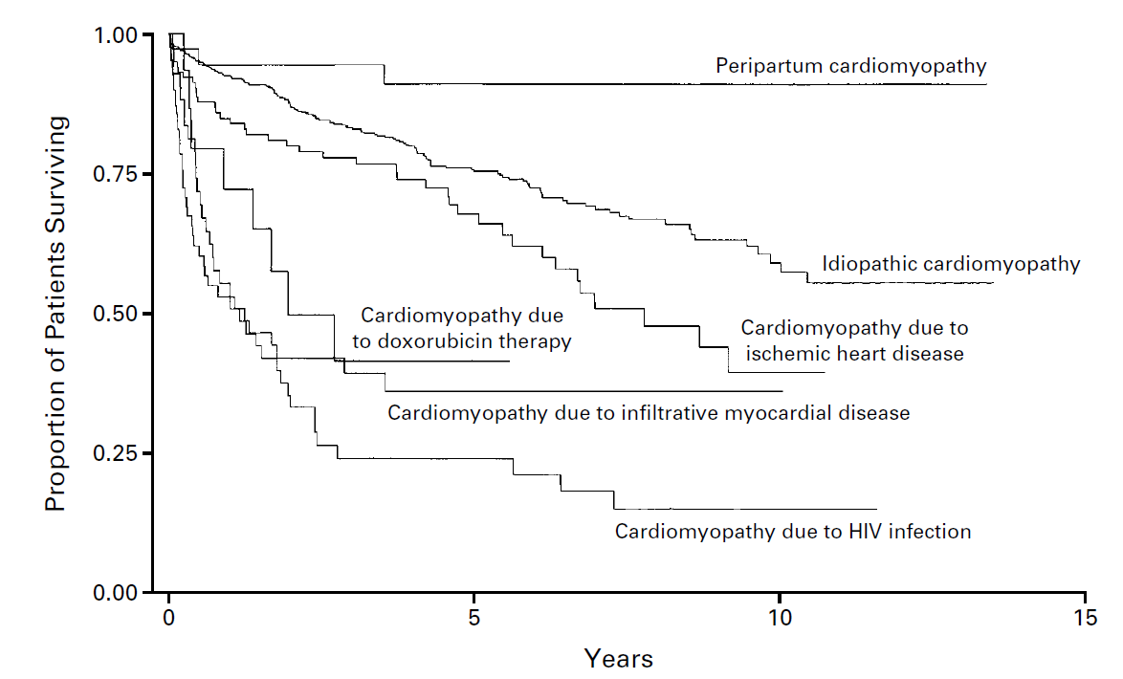
Survival PPCM vs. other CM
Felker, G M et al. (2000). Underlying causes and long-term survival in patients with initially unexplained cardiomyopathy. NEJM, 342(15), 1077-1084

Slide 50
Complex & Cyanotic heart disease

Slide 51
Cyanotic CHD
44 patients - 96 pregnancies
Adverse fetal outcome associated with ↑ Hb, ↓ O2, type of CHD, functional class
Fetal outcomes
↑ fetal loss (57%)
↑ Premature birth (37%)
↑ LBW infants
↑ CHD in offspring (5%)
Maternal outcomes
32% pt CV complications
1 death from endocarditis

Slide 52
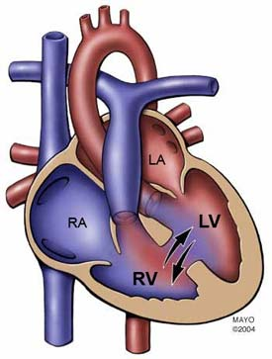
Eisenmenger Syndrome
Large L → R shunt produces pulmonary hypertension and irreversible PVD
Shunt reverses R → L causing cyanosis

Slide 53
Eisenmenger Syndrome
Very limited data on pregnancy
12 cases with 13 pregnancies
3 spontaneous abortions
1 premature labor 23 weeks
7 reach 3rd trimester
Bed rest, heparin, C-section
Deaths:
2 maternal deaths 23 – 27 weeks
1 Postpartum at 30 days (PE)

Slide 54
Valvular disease

Slide 55
ASD/AVSD and Pregnancy
ASD
Unrepaired ASD
↑ neonatal risk vs. repaired
↑ pre-eclampsia risk, SGA births
↑ fetal mortality
L to R shunt may ↑ with CO change during pregnancy, counterbalanced by ↓ PVR
Paradoxical embolism risk
Familial types- consider screening
AVSD
After repair - preg usually well tolerated without residual risks
Primum defect - well tolerated when functionally well
Down patient - 50% risk of transmitting trisomy 21
Warnes et al: JACC 2008 ACC/AHA Guidelines

Slide 56
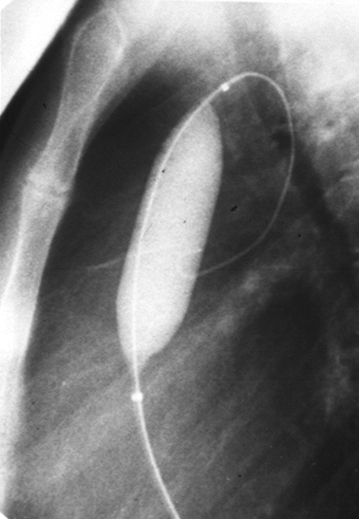
Pulmonic Stenosis
Pregnancy usually well tolerated unless very severe
Percutaneous valvotomy can be performed during pregnancy
No maternal CV events >100 preg
Outcome
Preterm delivery in 14.5%
Fetal mortality 0.8%
Perinatal mortality 4%
Recurrent CHD 3%
Noonan’s syndrome

Slide 57
Pulmonary stenosis
Anesthetic Management
Need to maintain:
LV
afterload
RV contractility
Euvolemia
Notes:
Much of the plan is dependent on RV contractility. If good, can tolerate more. If depressed VERY fine balance
Need to maintain LV after load: coronary perfusion only happens during diastole and with a thicker RV (due to hypertrophy) it does not take much to cause ischemic coronaries. ABOVE ALL: maintain RV contractility

Slide 58
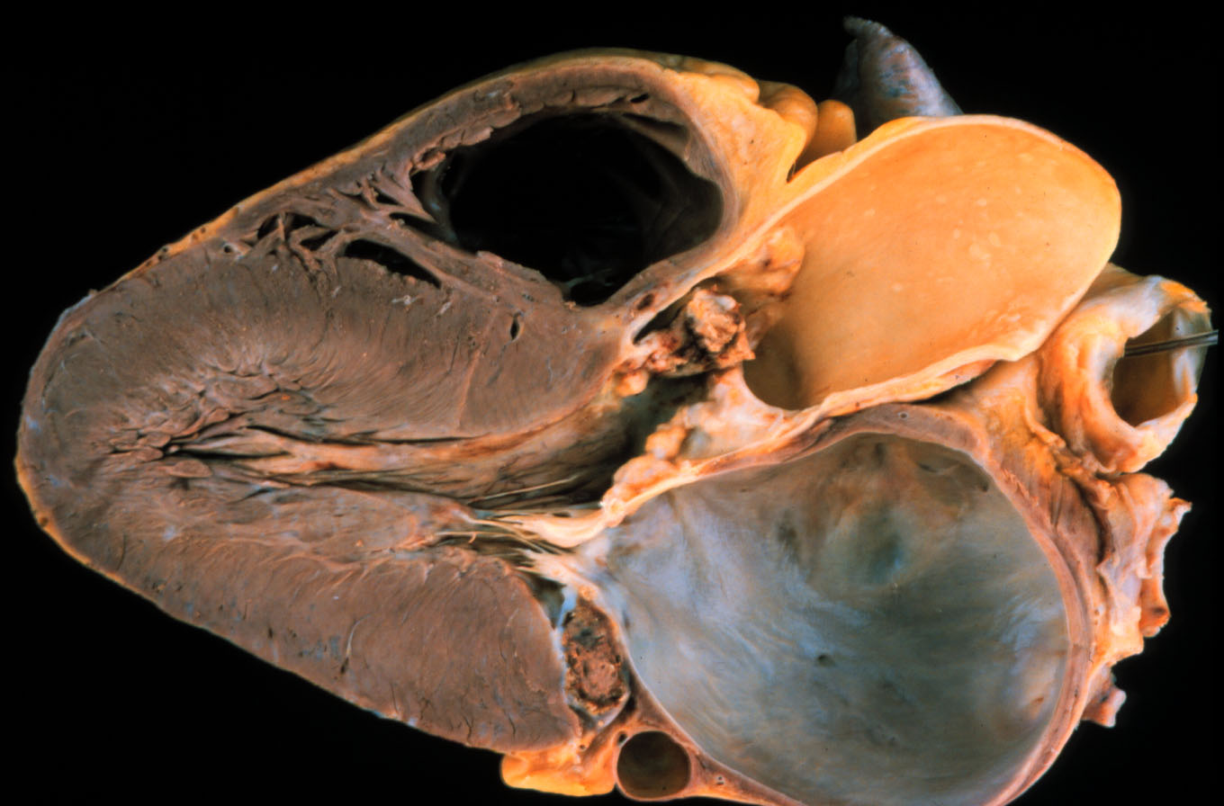
Aortic Stenosis
Notes:
CP1088236 Connolly,HM CW 11-13-2002

Slide 59
Aortic Stenosis
Preload and
hypotension
sensitive
Unable to
augment CO
CHF and ischemia
↓ placental perfusion IUGR, preterm labor
Suggest delivery at high-risk CV/OB center

Slide 60
Aortic Coarctation
Pregnancy generally well tolerated
↑ miscarriages and hypertensive disorders
Pre-pregnancy assessment –
associated lesions/residual coarctation severity, BAV, aorta
Study 50 pt - 118 pregnancies
SAB 9%, prematurity 3%, CHD 4% offspring
CV complications infrequent
1 Turner pt - dissection at 36 weeks
Hypertension
15 pt (30%) during pregnancy
11 (73%) had significant coarctation
Beauchesne et al: JACC 2001
Warnes et al: JACC 2008 ACC/AHA Guidelines

Slide 61
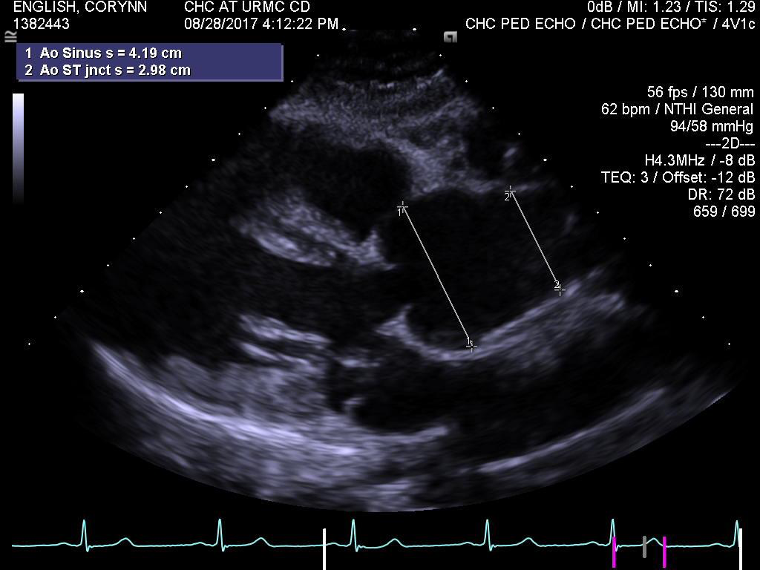
Marfan Syndrome
Deficient in fibrillin
Fragility → dilatation
Cardiovascular issues
Widened aortas
aortic dissection & aortic regurgitation
MVP can be present too
Unpredictable maternal risk-- Dissection, rupture, IE, CHF
Risk based on:
Changes with pregnancy- Physiologic, hormonal
Preexisting medial changes
Fetal risks- 50% inheritance-- Autosomal dominant

Slide 62
Marfan syndrome: pregnancy management
Aortic imaging
Aorta >45 mm → no pregnancy
Aorta ≤40 mm → reasonable if low risk otherwise
Aorta 40-45 mm → individualize
During pregnancy
Beta-blocker
Regular aortic imaging (individualize)
Fetal echo
Genetic counseling
Watch for other Marfan’s issues (joint, lens sublux, etc.)

Slide 63
Cardiovascular Management
Potential for aortic root dissection
Meticulous attention to blood pressure control
Beta-adrenergic receptor antagonist therapy
Minimize sheer stress
+
Minimize increases in aortic wall tension
Notes:
Beta blocker treatment delays dilatation

Slide 64
Marfan syndrome: pregnancy management
Peripartum
Facilitated vaginal delivery (minimize Valsalva)
C-section for aorta >40 mm or increasing in size
Postpartum
Dissection risk persists
FU with cardiology at 6-8 week
High index of suspicion with symptoms
Future evaluation of lactation risk

Slide 65
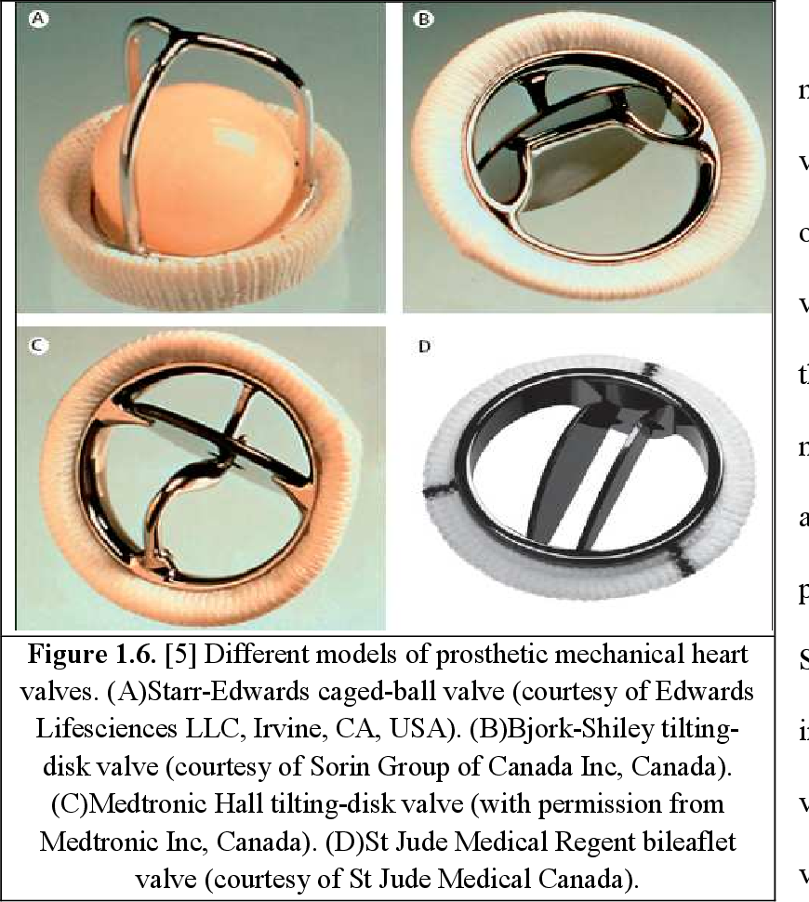
Mechanical Valves
Can by in any position, variety of types
Pregnancy increases thrombosis & embolism risk
⇡ clotting factors, platelet adhesiveness
⇣ fibrinolysis & protein S activity
Highest risk for thrombosis at “low flow” sites (mitral)
Require anticoagulation
Vitale, J Am Coll Cardiol 1999;
Oakley Br Heart J 1995; Melissari Thrombo Hemost 1992

Slide 66
How to anti-coagulate prostatic valves
Warfarin:
Crosses placenta
Increased loss, PTB, stillbirth
ICH risk
Embryopathy
6-12 wk exposure (4-10%)
Dose related
<5 mg– low/minimal risk
>5 mg- 9%
UFH:
Doesn’t cross placenta
Short ½ life = variable response
Increase risk
valve thrombosis
TE events
Maternal/Fetal Mortality
LMWH:
Advantages: High bioavailability, ease of administration, low SE
Inadequate during pregnancy for MHV
Measure anti-Xa activity
Peak (4 hours post) ~ 1 U/mL
Anti-Xa adjusted LMWH +ASA vs. Warfarin
Decreased risk PV thrombosis
Improved fetal outcomes
Vitale, J Am Coll Cardiol 1999;
Oakley Br Heart J 1995; Melissari Thrombo Hemost 1992

Slide 67
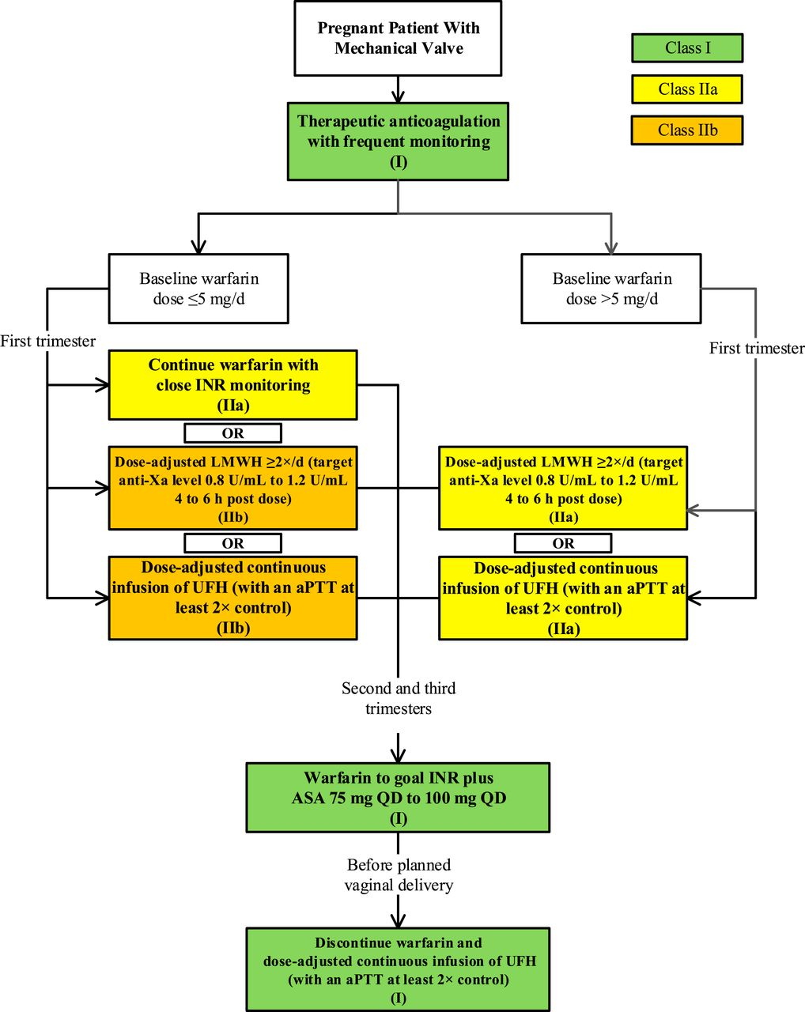
2014 AHA/ACC Guideline for the Management of Patients With Valvular Heart Disease

Slide 68
2014 AHA/ACC Guideline for the Management of Patients With Valvular Heart Disease

Slide 69
Anticoagulation strategies in PV in pregnancy
Steinberg ZL, et al. J Am Coll Cardiol. 2017

Slide 70
Summary
CVD 1-2% of all pregnancies
CHD most common in N. Amer.
Doesn’t preclude pregnancy
↑ risk to mother and fetus
Individual assessment
Multidisciplinary care

Slide 71
References

Slide 72
WHO I
Risk Class | Pregnancy Risk by Medical Condition
I | No detectable increased risk of maternal mortality No/mild increase in morbidity
 | Low Risk Cardiology eval once or twice during pregnancy
 | Uncomplicated, small/mild pulmonary stenosis, PDA, mitral valve prolapse Successfully repaired simple lesions (ASD, VSD, PDA, anomalous pulmonary venous drainage). Atrial or ventricular ectopic beats, isolated

Slide 73
WHO II
Risk Class | Pregnancy Risk by Medical Condition
II | Small increased risk of maternal mortality or moderate increase in morbidity
 | Low-moderate Risk Cardiology eval q trimester
 | Unoperated atrial or ventricular septal defect Repaired tetralogy of Fallot Most arrhythmias
II-III Varies by patient | Mild left ventricular impairment Hypertrophic cardiomyopathy Native or tissue valvular heart disease not considered WHO I or IV Marfan syndrome without aortic dilatation Aorta <45 mm in aortic disease associated with bicuspid aortic valve Repaired coarctation

Slide 74
WHO III
Risk Class | Pregnancy Risk by Medical Condition
III | Significantly increased risk of maternal mortality or severe morbidity. Expert counselling required. If pregnancy is decided upon, intensive specialist cardiac and obstetric monitoring needed throughout pregnancy, childbirth and the puerperium.
 | High Risk Cardiology eval q 2-4 weeks
 | Mechanical valve Systemic right ventricle Fontan circulation Cyanotic heart disease (unrepaired) Other complex congenital heart disease Aortic dilatation 40-45 mm in Marfan syndrome Aortic dilatation 45-50 mm in aortic disease associated with bicuspid aortic valve

Slide 75
WHO IV
Risk Class | Pregnancy Risk by Medical Condition
IV | Extremely high risk of maternal mortality or severe morbidity; pregnancy contraindicated. If pregnancy occurs termination should be discussed. If pregnancy continues, care as for class III.
 | ADVISED AGAINST PREGNANCY Discuss Pregnancy termination
 | Pulmonary arterial hypertension – any cause Severe systemic ventricular dysfunction (LVEF <30%, NYHA III-IV) History of PPCM with any residual LV dysfunction Severe mitral stenosis, severe symptomatic aortic stenosis Aortic dilatation >45 mm in Marfan syndrome Aortic dilatation >50 mm in aortic disease associated with bicuspid aortic valve Native severe coarctation

Slide 76
CHD:
Ariane J. Marelli. Circulation. Lifetime Prevalence of Congenital Heart Disease in the General Population From 2000 to 2010, Volume: 130, Issue: 9, Pages: 749-756, DOI: (10.1161/CIRCULATIONAHA.113.008396)
Marelli, A. J., et. al. (2014). Lifetime Prevalence of Congenital Heart Disease in the General Population From 2000 to 2010. Circulation, 130(9), 749-756.
Canobbio, M. M., et. al. (2017). Management of Pregnancy in Patients With Complex Congenital Heart Disease: A Scientific Statement for Healthcare Professionals From the American Heart Association. Circulation.

Slide 77
Evidence
Guidelines
Regitz-Zagrosek V, Lundqvist C, Borghi C, et al. ESC Guidelines on the management of cardiovascular diseases during pregnancy. Eur Heart J. 2011; 32(24):3147-97.
Warnes CA, Williams RG, Bashore TM, et al ACC/AHA 2008 guidelines for the management of adults with congenital heart disease. J Am Coll Cardiol. 2008;52(23): e143-263.
Level II-2:
Siu S, Sermer M, Colman J, et al. Cardiac Disease in Pregnancy (CARPREG) Investigators Prospective Multicenter Study of Pregnancy Outcomes in Women with Heart Disease Circulation 2001;104(5):515-21.
Level II-3:
Drenthen W, Boersma E, Balci A, et al; ZAHARA Investigators. Predictors of pregnancy complications in women with congenital heart disease. Eur Heart J 2010; 31(17): 2124-2132
Drenthen W, Pieper PG, Roos-Hesselink JW, et al; ZAHARA Investigators. Outcome of Pregnancy in women with congenital heart disease, a literature review. J Am Coll Cardiol. 2007; 49(24):2303-11.

Slide 78
Evidence
Level II-3:
Drenthen W, Pieper PG, Roos-Hesselink JW, et al: Zahara Investigators. Non-Cardiac complications during pregnancy in women with isolated congenital pulmonary valvar stenosis. Heart. 2006;92(12):1838-43.
Yap SC, Drenthen W, Pieper PG, et al for Zahara Investigators. Risk of complications during pregnancy in women with congenital aortic stenosis. Int J Cardiol. 2008;126(2):240-6.
Drenthen W, Boersma E, Balci A, et al for Zahara Investigators. Predictors of pregnancy complications in women with congenital heart disease. Eur Heart J. 2010;31(17):2124-32.
Yap SC, Drenthen W, Meijboom FJ, et al for Zahara Investigators. Comparison of pregnancy outcomes in women with repaired versus unrepaired atrial septal defect. British J Obstet and Gyn BJOG. 2009; 116(12):1593-601.
Vriend JW, Drenthen W Pieper PG, et al. Outcome of pregnancy in patients after repair of aortic coarctation. Eur Heart J. 2005;26(20):2173-8.

Slide 79
Evidence
Level II-3:
John AS, Gurley F, Schaff HV, et al. Cardiopulmonary bypass during pregnancy. Ann Thorac Surg. 2011; 91(4):1191-6
Hameed A, Karaalp IS, Tummala PP, et al. The effect of valvular heart disease on maternal and fetal outcome of pregnancy. J Am Coll Cardiol. 2001 Mar 1;37(3):893-9.
Beauchesne LM, Connolly HM, Ammash NM, et al. Coarctation of the aorta: outcome of pregnancy. J Am Coll Cardiol. 2001 Nov 15;38(6):1728-33.
Connolly HM, Warnes CA. Ebstein's anomaly: outcome of pregnancy. J Am Coll Cardiol. 1994 Apr;23(5):1194-8.
Presbitero P, Somerville J, Stone S, et al. Pregnancy in cyanotic congenital heart disease. Outcome of mother and fetus. Circulation. 1994;89(6):2673-6.
Avila WS, Grinberg M, Snitcowsky R et al. Maternal and fetal outcome in pregnant women with Eisenmenger's syndrome. Eur Heart J. 1995;16(4):460-4.

Slide 80
Evidence
REFERENCES
• Bachelier-Walenta, Katrin, Hilfiker-Kleiner, Denise, & Sliwa, Karen. (2013). Peripartum cardiomyopathy. Curr Opin Crit Care, 19(5), 397-403. doi: 10.1097/MCC.0b013e328364d7db (Level III)
• Blauwet, L A, & Cooper, L T. (2011). Diagnosis and management of peripartum cardiomyopathy. Heart (British Cardiac Society), 97(23), 1970-1981. doi: 10.1136/heartjnl-2011-300349 (Level III)
• Cooper, L. T., Mather, P. J., Alexis, J. D., Pauly, D. F., et al. (2012). Myocardial recovery in peripartum cardiomyopathy: prospective comparison with recent onset cardiomyopathy in men and nonperipartum women. J Card Fail, 18(1), 28-33. doi: 10.1016/j.cardfail.2011.09.009 (Level II-2)
• Demakis, J. G., & Rahimtoola, S. H. (1971). Peripartum cardiomyopathy. Circulation, 44(5), 964-968. Level III)
• Elkayam, U., Tummala, P. P., Rao, K., Akhter, M. W., Karaalp, I. S., Wani, O. R., et al. (2001). Maternal and Fetal Outcomes of Subsequent Pregnancies in Women with Peripartum Cardiomyopathy. The New England journal of medicine, 344(21), 1567–1571. doi:10.1056/NEJM200105243442101(Level II-2)
• Felker, G M, Thompson, R E, Hare, J M, Hruban, R H, Clemetson, D E, et al. (2000). Underlying causes and long-term survival in patients with initially unexplained cardiomyopathy. The New England journal of medicine, 342(15), 1077-1084. doi: 10.1056/NEJM200004133421502 (Level II-3)

Slide 81
Evidence
REFERENCES – continued
• Habli, Mounira, O&apos;Brien, Thomas, Nowack, Elizabeth, Khoury, Saeb, Barton, John R, & Sibai, Baha. (2008). Peripartum cardiomyopathy: prognostic factors for long-term maternal outcome. American journal of obstetrics and gynecology, 199(4), 415.e411-415. doi: 10.1016/j.ajog.2008.06.087 (Level II-3)
• Harper, Margaret A, Meyer, Robert E, & Berg, Cynthia J. (2012). Peripartum cardiomyopathy: population-based birth prevalence and 7-year mortality. Obstet Gynecol, 120(5), 1013-1019. doi: 10.1097/AOG.0b013e31826e46a1 (Level II-3)
• Heart Failure Society Of, America. (2006). Executive summary: HFSA 2006 Comprehensive Heart Failure Practice Guideline. J Card Fail, 12(1), 10-38. doi: 10.1016/j.cardfail.2005.12.001(Level III)
• Hilfiker-Kleiner, D., Struman, I., Hoch, M., Podewski, E., & Sliwa, K. (2012). 16-kDa prolactin and bromocriptine in postpartum cardiomyopathy. Curr Heart Fail Rep, 9(3), 174-182. doi: 10.1007/s11897-012-0095-7 (Level III)
• Johnson-Coyle, L., Jensen, L., Sobey, A., American College of Cardiology, Foundation, & American Heart, Association. (2012). Peripartum cardiomyopathy: review and practice guidelines. Am J Crit Care, 21(2), 89-98. doi: 10.4037/ajcc2012163 (Level III)
• Lata, I., Gupta, R., Sahu, S., & Singh, H. (2009). Emergency management of decompensated peripartum cardiomyopathy. J Emerg Trauma Shock, 2(2), 124-128. doi: 10.4103/0974-2700.50748 (Level III)

Slide 82
Evidence
REFERENCES – continued
• Manolio, T. A., Baughman, K. L., Rodeheffer, R., Pearson, T. A., Bristow, J. D., et al. (1992). Prevalence and etiology of idiopathic dilated cardiomyopathy (summary of a National Heart, Lung, and Blood Institute workshop. Am J Cardiol, 69(17), 1458-1466. (Level II-3)
• Natalie Bello, M. D., Iliana S Hurtado Rendon, M. D., & Zoltan Arany, M. P. (2013). Accepted Manuscript. Journal of the American College of Cardiology, 1–35. doi:10.1016/j.jacc.2013.08.717 (Level I)
• Patten, Ian S, Rana, Sarosh, Shahul, Sajid, Rowe, Glenn C, Jang, Cholsoon, et al. (2012). Cardiac angiogenic imbalance leads to peripartum cardiomyopathy. Nature, 485(7398), 333-338. doi: 10.1038/nature11040 (Level III)
• Sliwa, K, Blauwet, L, Tibazarwa, K, Libhaber, E, Smedema, J P, et al. (2010). Evaluation of Bromocriptine in the Treatment of Acute Severe Peripartum Cardiomyopathy: A Proof-of-Concept Pilot Study. Circulation, 121(13), 1465-1473. doi: 10.1161/CIRCULATIONAHA.109.901496 (Level I)

